Slide 1


End-to-End ML Project: “Health Score Predictor”
Predicting Health Status (Good / Bad) with Machine Learning
.
Project presented by:
S.Yoga
This Photo by Unknown Author is licensed under CC BY-SA-NC
Notes:
Begin by introducing yourself and the purpose behind creating the Health Score Predictor project. Explain that the goal was to use machine learning not only as a technical exercise but as a meaningful application in preventive healthcare. Highlight how the model classifies health status based on measurable factors such as BMI, activity, and sleep, and why such predictive tools are increasingly vital for personalized wellness.
Emphasize that this project demonstrates the full lifecycle of an ML workflow—from data acquisition and cleaning, to model training and deployment. Stress the use of Streamlit for interactivity, turning a static model into a live application accessible by non-technical users.
Conclude by positioning this project as an example of how AI can translate data-driven insights into real-world health improvements, serving as both an academic and practical demonstration of machine learning’s impact.

Slide 2




Project Objective & Overview
Building a Supervised ML App for Health Score Prediction
Objective
Develop a supervised machine learning model capable of predicting overall health scores as 'Good' or 'Bad' based on biometric and behavioral data.
Approach
Evaluate multiple classification algorithms—Logistic Regression, Random Forest, and Gradient Boosting—to identify the best-performing model for deployment.
Deployment
Deploy the final model using Streamlit for real-time, interactive predictions with an intuitive user interface accessible to non-experts.
Expected Outcome
Deliver a functional end-to-end ML application that demonstrates data-driven decision-making in healthcare contexts.
Notes:
In this slide, explain the overarching purpose of your Health Score Predictor project. Start by framing the problem: predicting whether an individual’s health status is likely to be 'Good' or 'Bad' using key health indicators.
Discuss your use of a supervised learning framework—why labeled data enables accurate classification—and how you benchmarked multiple algorithms to identify the most reliable model. Highlight that performance evaluation guided the model selection process, ensuring both accuracy and interpretability.
Conclude by noting that deployment through Streamlit transforms your trained model into an interactive application, bridging data science and user experience to support everyday health monitoring.

Slide 3
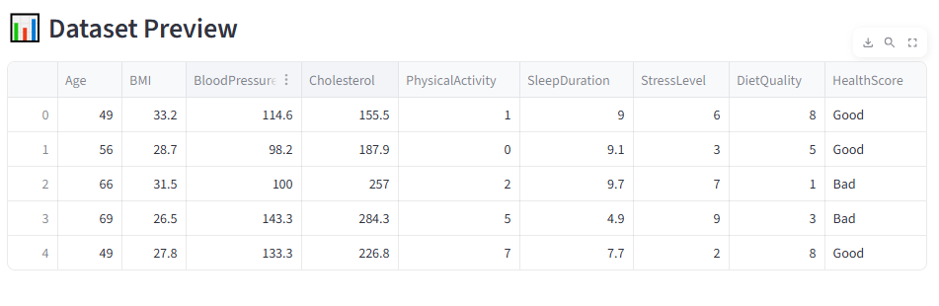
Input Features & Target Variable
Understanding Predictors and Outputs in Health Score Modeling
Feature Set: Core features include Age, BMI, Blood Pressure, Cholesterol, Activity, Sleep, Stress, and Diet—each quantifying lifestyle and physiological patterns.
  Feature Influence: High BMI, elevated cholesterol, and poor sleep patterns correlate with negative health outcomes, while active lifestyles and balanced diets indicate better scores.
  Target Variable: The binary target, Health Score (Good / Bad), reflects overall wellness and is determined from the interplay of input metrics.
  Feature-Outcome Relationship: Feature engineering ensures meaningful correlations by transforming raw data into standardized numerical inputs for ML algorithms.
Notes:
Explain the key features driving your model’s predictions. Discuss how the selected parameters represent a mix of biological, behavioral, and lifestyle indicators.
Describe the reasoning for choosing these eight inputs—each variable contributes a measurable dimension to overall wellness. For example, BMI and cholesterol capture physiological health, while activity and sleep reflect behavioral factors.
Conclude by clarifying that the model predicts a binary target (Good vs. Bad health). This classification simplifies interpretation and enables actionable insights, which are crucial for preventive healthcare applications.

Slide 4



Model Training
Building and Optimizing Predictive Models
Training Setup
Data split into training and testing sets to ensure model generalization and avoid overfitting.
Algorithm Selection
Implemented Logistic Regression, Random Forest, and Gradient Boosting as comparative supervised learning models.
Hyperparameter Tuning
Optimized parameters such as learning rate and regularization strength to maximize accuracy.
Evaluation Metric
Accuracy was selected as the key metric, balancing interpretability and relevance for balanced datasets.
Notes:
Detail your model training pipeline, explaining the rationale for splitting the dataset into training and test sets to assess generalization. Describe how you compared different algorithms—Logistic Regression for interpretability, Random Forest for robustness, and Gradient Boosting for complexity.
Discuss hyperparameter tuning techniques and how iterative testing improved performance. Reinforce that using accuracy as the main metric makes sense in this context due to a balanced dataset.
Conclude by noting how this stage bridges the gap between exploratory insights and measurable predictive performance.

Slide 5
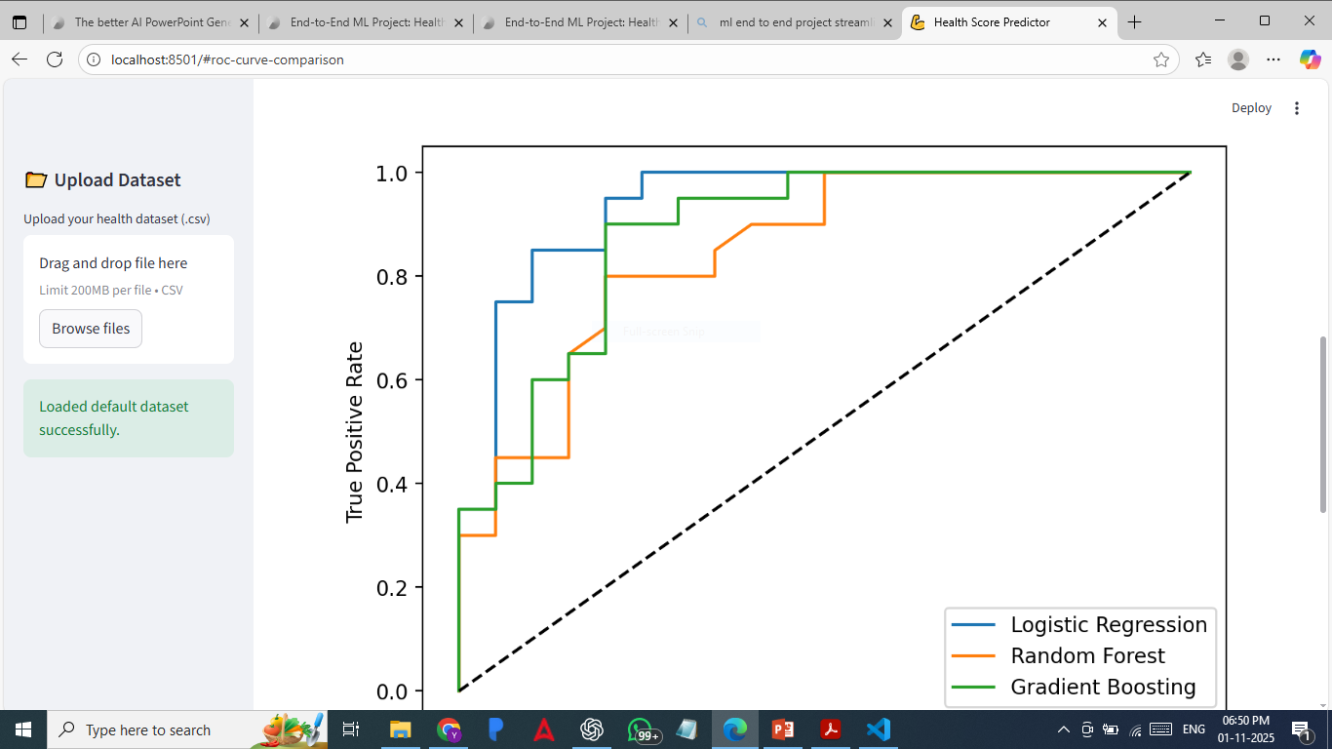
Model Evaluation
Comparing Accuracy and Performance Across Algorithms
Model Results: Logistic Regression achieved 82% accuracy, outperforming Random Forest (75%) and Gradient Boosting (72%).
  Performance Insights: Logistic Regression demonstrated superior generalization and stability across multiple test runs.
  ROC Analysis: Receiver Operating Characteristic curve indicated strong class separation and minimal false positives.
  Model Selection Criteria: Selected model balances simplicity, speed, and interpretability—critical for healthcare use cases.
Notes:
Present your evaluation findings, focusing on comparative performance across the three tested algorithms. Emphasize that Logistic Regression achieved the highest accuracy while maintaining transparency in how decisions are made.
Explain the meaning of the ROC curve and how it validates classification performance by showing strong separation between classes. Highlight that interpretability and speed were prioritized for deployment.
Wrap up by linking these results to real-world usability—simple, explainable models are often more trusted in health-related applications.

Slide 6
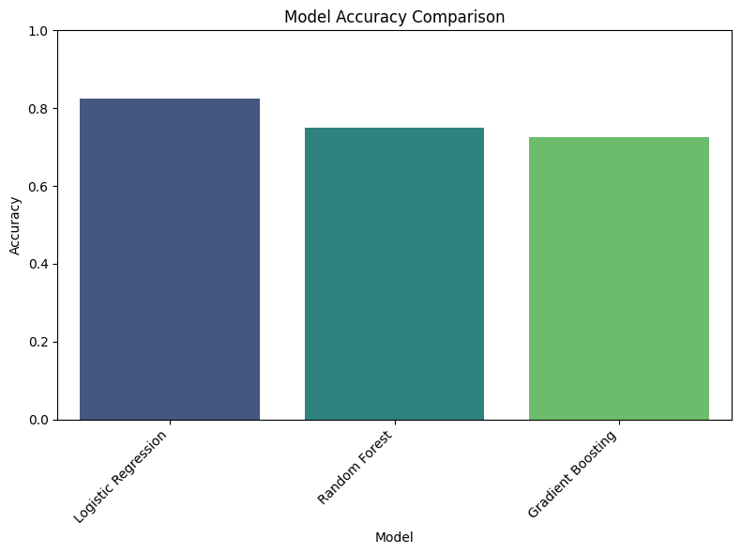
Best Model – Logistic Regression
Final Model Selection and Justification
Top Performer: Logistic Regression achieved the best trade-off between accuracy, interpretability, and computational efficiency.
  Model Stability: Consistently high performance across cross-validation folds confirmed robustness against random data variation.
  Interpretability Advantage: Coefficients directly show how each feature influences prediction—crucial for explaining results in healthcare.
  Deployment Choice: Selected as final model for Streamlit deployment due to simplicity, transparency, and excellent accuracy.
Notes:
Discuss why Logistic Regression was ultimately chosen as the best model. Emphasize that its balance of interpretability and accuracy makes it ideal for healthcare analytics, where clarity of prediction is essential.
Explain that it not only performed well but also remained computationally light, allowing real-time deployment in Streamlit. Reinforce the benefit of visible coefficients for interpretability.
Conclude by noting that this model embodies the project’s goal: accurate, understandable, and actionable health predictions.

Slide 7
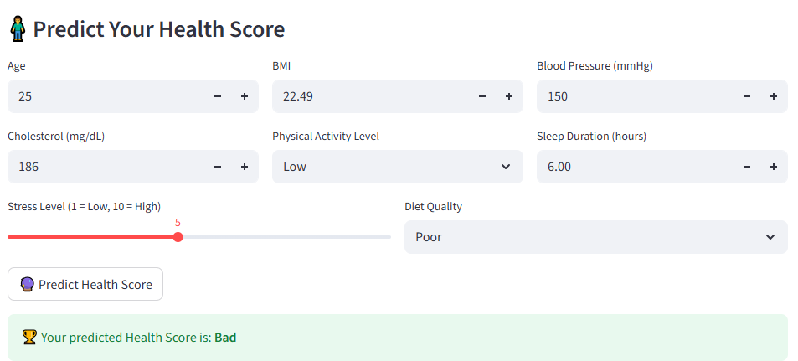




Streamlit App Deployment
From Model to Interactive Web Application
User Interaction
Streamlit interface allows users to input metrics like BMI, sleep, and cholesterol to receive instant predictions.
Backend Integration
Model and StandardScaler objects serialized with Joblib and loaded into Streamlit for consistent inference.
Accessible Design
Clean UI design ensures ease of use for non-technical users, promoting engagement and health awareness.
End-to-End Flow
Real-time predictions demonstrate how machine learning models can power user-centric health analytics applications.
Notes:
Demonstrate how your model was operationalized using Streamlit. Explain how the web interface lets users input their health metrics and instantly view predicted health status.
Describe how you saved and loaded the model and scaler using Joblib, ensuring repeatable, consistent results. Emphasize the design simplicity of Streamlit—its ability to transform data science projects into functional, interactive tools.
Wrap up by showing how this app completes the end-to-end ML pipeline—from raw data to real-time predictions in a user-friendly web environment.

Slide 8
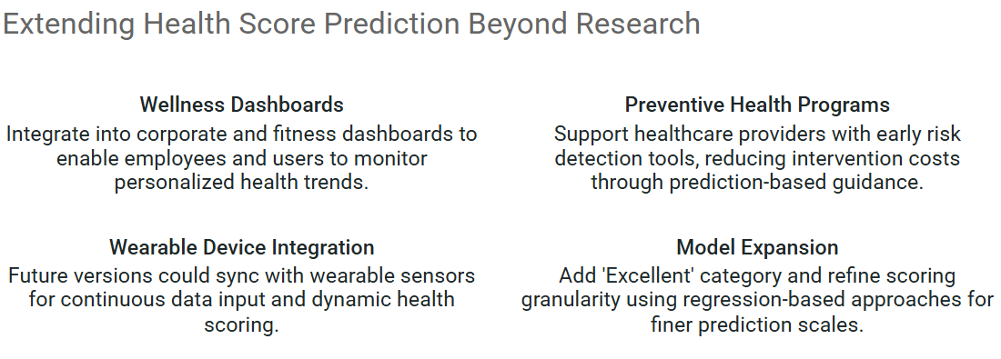
Applications & Future Enhancements

